Slide 1
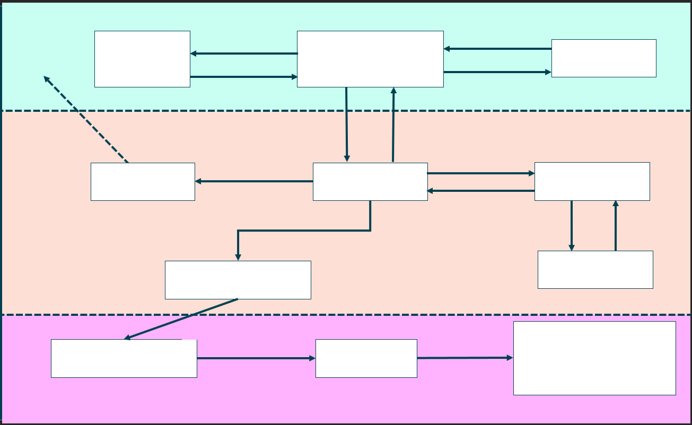

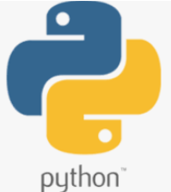
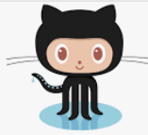

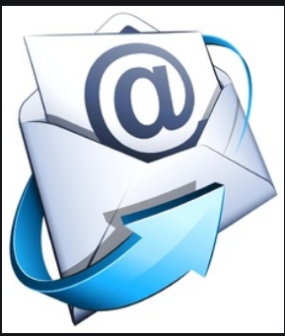


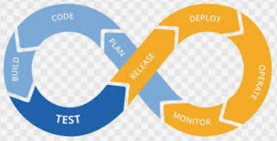
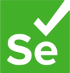



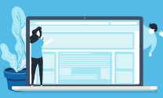

Pull
Version Control System
Get Work
Project Tracking
Source Code
Developers
Jira
GITHUB
Update Work
Push
Email the Devs
Pull Code
DEVOPS
Poll Code
Build Report
Send Code
Build Tool
Email Server
CI server
Travis
Build Results
Run Tests
Test Results
Send Artefact
Testing Tool
Artefact Repository
SELENIUM
Kubernetes
Test Artefact
Live Environment
Testing Environment
Staging Environment
Environment Testing Done
Staging Passed
AWS
Testers

Slide 2
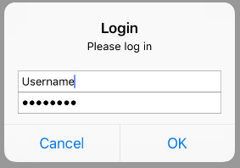
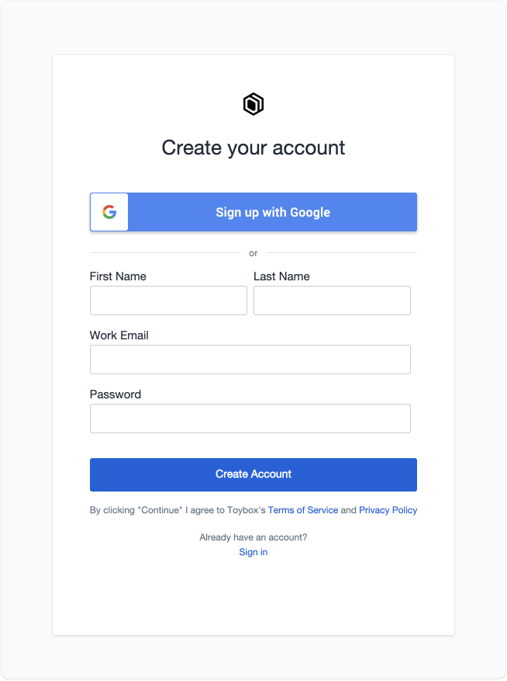
Miniblocks Exhibitions
Miniblocks Exhibitions
Login page
Create an account page
Create an account

Slide 3
Miniblocks Exhibitions
Miniblocks Exhibitions
Login page opens to
Items
Exhibitions
Items
Exhibitions
Create
CRUD
Search
Halls
Update
Dates
Delete
Locations

Slide 4
Miniblocks Exhibitions
Miniblocks Exhibitions
CREATE ITEM page
SEARCH ITEM page
Name
Search Item
Dropdown box
Age Level
Difficulty Level
Number of Pieces
Date Built
Name
Comments
Number of Pieces
Photo
Photo

Slide 5
Miniblocks Exhibitions
Miniblocks Exhibitions
UPDATE ITEM page
DELETE ITEM page
Choose an
Item
Choose an
Item
Dropdown box
Dropdown box
Name
Item has been deleted
Comments
Photo

Slide 6
Miniblocks Exhibitions
Miniblocks Exhibitions
SEARCH EXHIBITION page
CREATE EXHIBITION page
Name
Search Item (1)
Dropdown box
Description
Search Hall (2)
Dropdown box
Exhibition Date
Search Date (3)
Dropdown box
Duration
Search Location (4)
Dropdown box
Location
Depending on the search chosen, this screen will bring up different settings
Comments
Name
1-2-3-4
Description
1-2
Photo
Exhibition Date
2-4
Location
2-3

Slide 7
Miniblocks Exhibitions
Miniblocks Exhibitions
UPDATE EXHIBITION page
DELETE EXHIBITION page
Choose an
Item
Choose an
Item
Dropdown box
Dropdown box
Name
Item has been deleted
Description
Exhibition Date
Duration
Location

Slide 8
Miniblocks Exhibitions
Miniblocks Exhibitions
UPDATE EXHIBITION page
DELETE EXHIBITION page
Choose an
Item
Choose an
Item
Dropdown box
Dropdown box
Name
Item has been deleted
Description
Exhibition Date
Duration
Location

